Slide 1




Drugs abuse
Amogh Shukla 19BCE0785 Divij Bahl 19BCE0785 Aryan Shridhar 19BCE0801
Vedant Vikas Naik 19BCE0797 Akshat Srivastav 19BCE0811

Slide 2


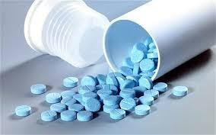
What is a drug ?
A drug is any chemical substance that when absorbed into the body of a living organism alters the normal function of the body.

Slide 3

What is drug abuse ?
Drug abuse is a patterned use of a substance (drug) in which the user consumes the substance in amounts or with methods neither approved nor supervised by medical professionals.

Slide 4

Drug addiction:
After drug abuse comes drug addiction.
Taking a drug causes a sudden increase in levels of dopamine in your brain, which trigger feelings of pleasure.
Your brain remembers these feelings and wants them repeated.
Drugs
Drug Abuse
Drug Addiction

Slide 5

Types of drugs
Legal drugs
Illegal drugs

Slide 6
Legal drugs:
Legal drugs are intoxicating drugs which are not prohibited .
Examples:
Caffeine
Nicotine
Sleeping pills
Alcohol
Betel nuts

Slide 7


Caffeine:
Coffee contains caffeine which
,when consumed in excess can be addictive, stimulate, and a mood charger.
It’s side effect:
A large amount of coffee or caffeine consumed all at once can have a negative affect on blood sugar levels that influences fat burning that could change into storing fat.

Slide 8
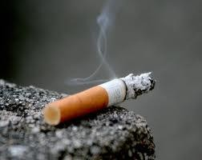
Nicotine:
Tobacco is a very common legal drug which contains nicotine. Excess consumption of tobacco Causes several health problems.
It’s Effects:
Lung cancer
Throat cancer
Pancreatic Cancer
Head and Neck Cancers
Stomach Cancer

Slide 9
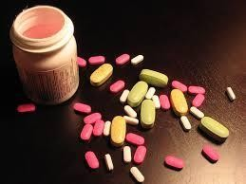
Sleeping pills :
It is a drug which helps to induce sleep.
It is generally prescribed to the people who have sleep disorder or physically injured (to ease the pain).
It’s Side Effects:
Burning or tingling in the hands, arms, feet, or legs
Changes in appetite
Constipation
Diarrhoea
Difficulty keeping balance
Dizziness
Drowsiness
Dry mouth or throat
Gas
Headache
Heartburn
Stomach pain or tenderness
Uncontrollable shaking of a part of
the body
Unusual dreams
Weakness

Slide 10

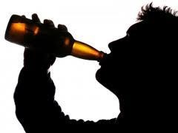
Alcohol:
Alcohol is a psychoactive drug that has a depressant
effect.
A high blood alcohol content is usually considered to be legal drunkenness because it reduces attention and slows reaction speed.
Effects
Heart disease
Stroke
Cancer
Diabetes
Obesity

Slide 11

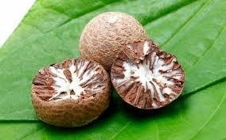
Betel Nuts:
Chewed nut popular in Asia
Effects
Excessive use leads to warm sensation, increased pulse rate, sweating
Prolonged use for many years may increase the risk for oral cancers

Slide 12
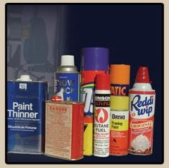
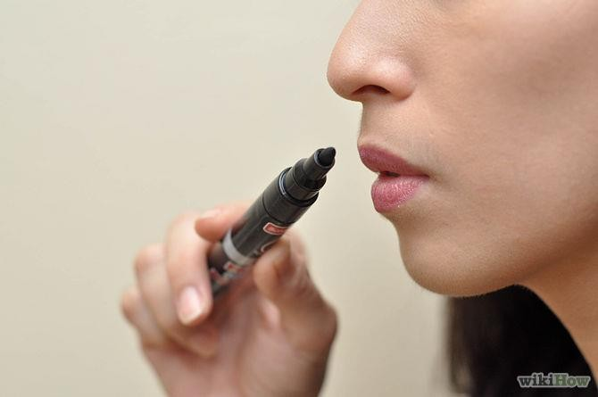
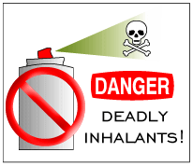
INHALANTS
Attract younger children, or adults who
can’t afford alcohol or street drugs

Slide 13

INHALA_{R}N_{isk}T_{s}S
lack of coordination
dizziness
euphoria
difficulty speaking
brain damage
organ damage
death caused by choking
high only lasts a few minutes, abusers inhale repeatedly and can lose consciousness or die

Slide 14

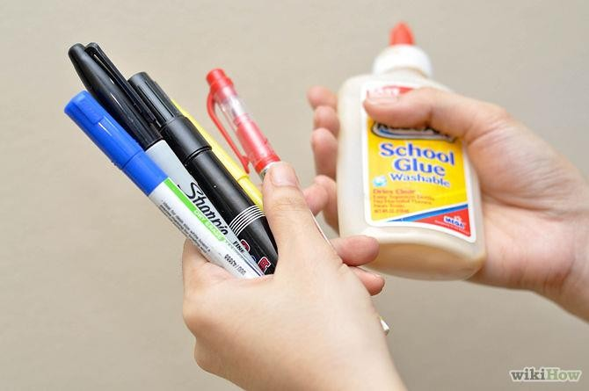
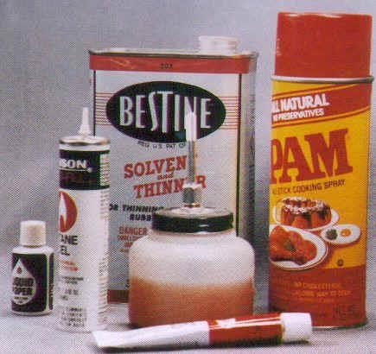
INHALANTS
Long time Risks
Long term users show weight loss, muscle weakness, irritability, depression

Slide 15

Illegal drugs

Slide 16
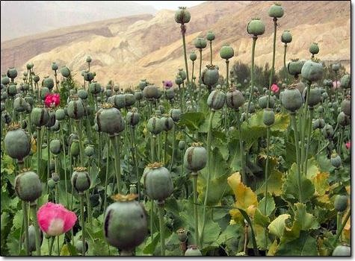
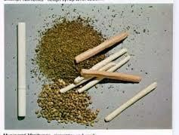
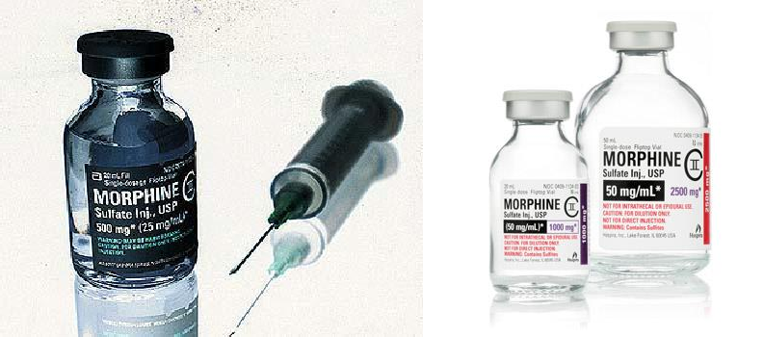
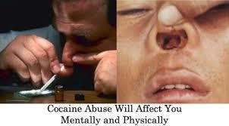
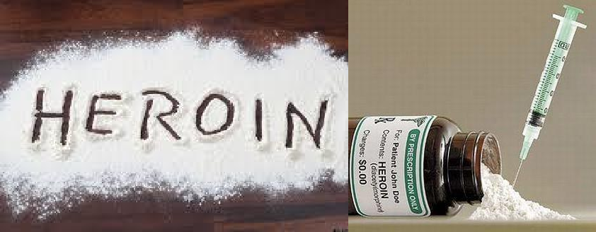
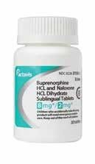
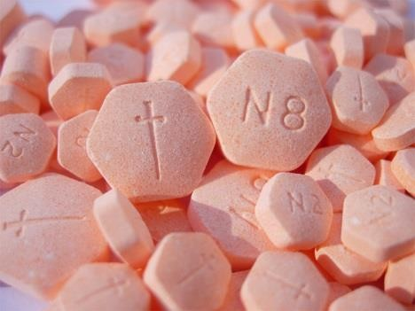
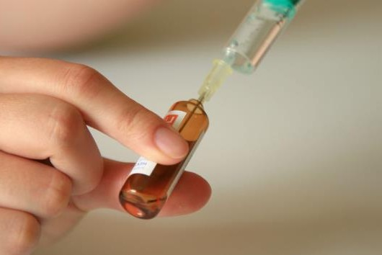
Opium – oral, inhalation,weed,pot
Morphine – injection
Heroin – injection, inhalation, chasing
Codeine – oral (tablets and cough syrups)
Buprenorphine – oral, injection

Slide 17

GANJA
Ganja is the most common illegal drug around the world
Comes from a plant called “cannabis”
Some people call it pot, weed, grass, hash, smoke.
Cannabis has the chemical “tetrahydrocannabinol” or
THC
When you smoke a joint the THC goes into the lungs, then into the heart which pumps into the bloodstream which takes it directly to brain

Slide 18
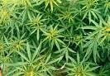
ganja
Short Term Effects:
Increase in heart rate, lead to anxiety and paranoia
Distorted concept of time
and space
Decrease in concentration skills, short-term memory capacity
Feeling tired after the
“high” wears off
Increase in appetite, weight gain
Long Term Effects:
Breathing problems
Lung cancer
Damage cells and tissues in the body that fight disease
Lack of motivation
Difficulty processing new information

Slide 19

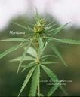
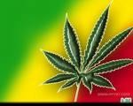
Marijuana
Marijuana and cigarette smoke have some of the same cancer-causing substances.
Benzopyrene (cancer-producing agent) higher in marijuana
400 chemicals in marijuana smoke affect lungs, throat and esophagus

Slide 20

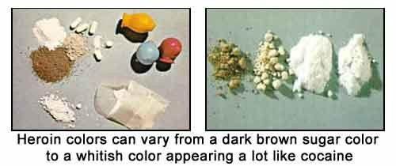
HEROIN
Processed from morphine – obtained from opium poppy
“downer” affects brain’s pleasure systems
– interferes with brains ability to feel pain

Slide 21

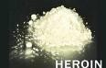
HEROIN
white to dark brown powder or tar-like
substance is cut with other drugs or substances (sugar, starch, powdered milk)
abusers don’t know actual strength of drug or true contents = high chance of overdose or death
sharing needles and equipment cause other diseases and problems fo
r users

Slide 22

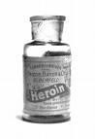
HEROIN
leads to flushing of skin, dry mouth, collapsed veins, liver disease
additives don’t dissolve and this leading to clogs in blood vessels that lead to lungs, liver, kidney or brain
tolerance develops with regular use – user needs more heroin to achieve same inte
nsity

Slide 23

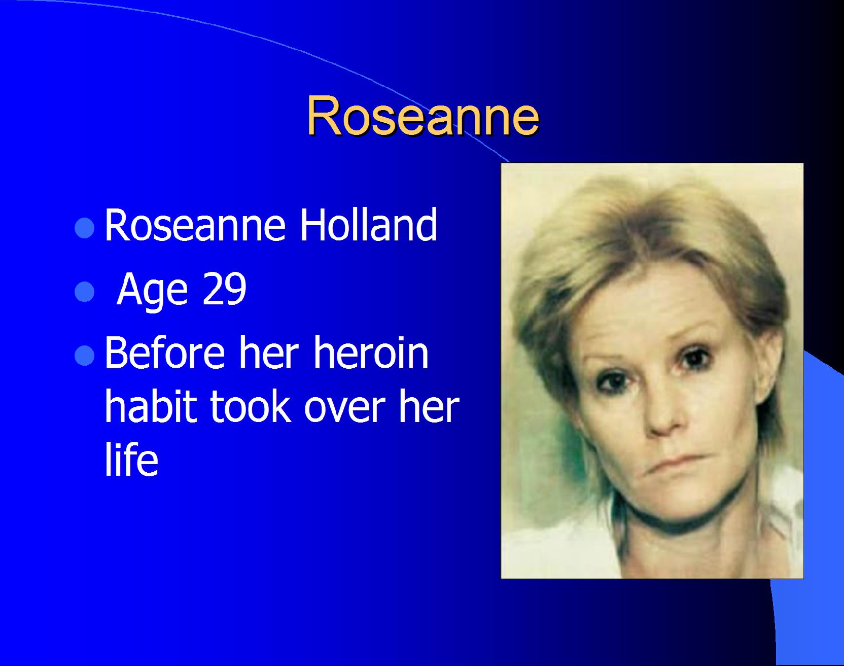

Slide 24

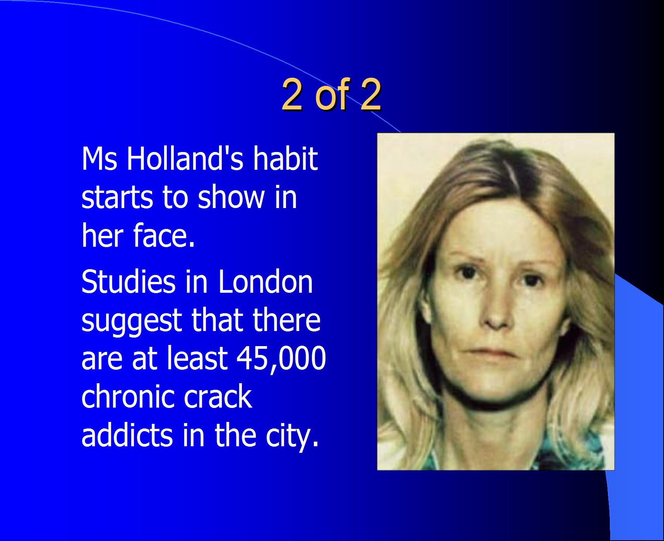

Slide 25

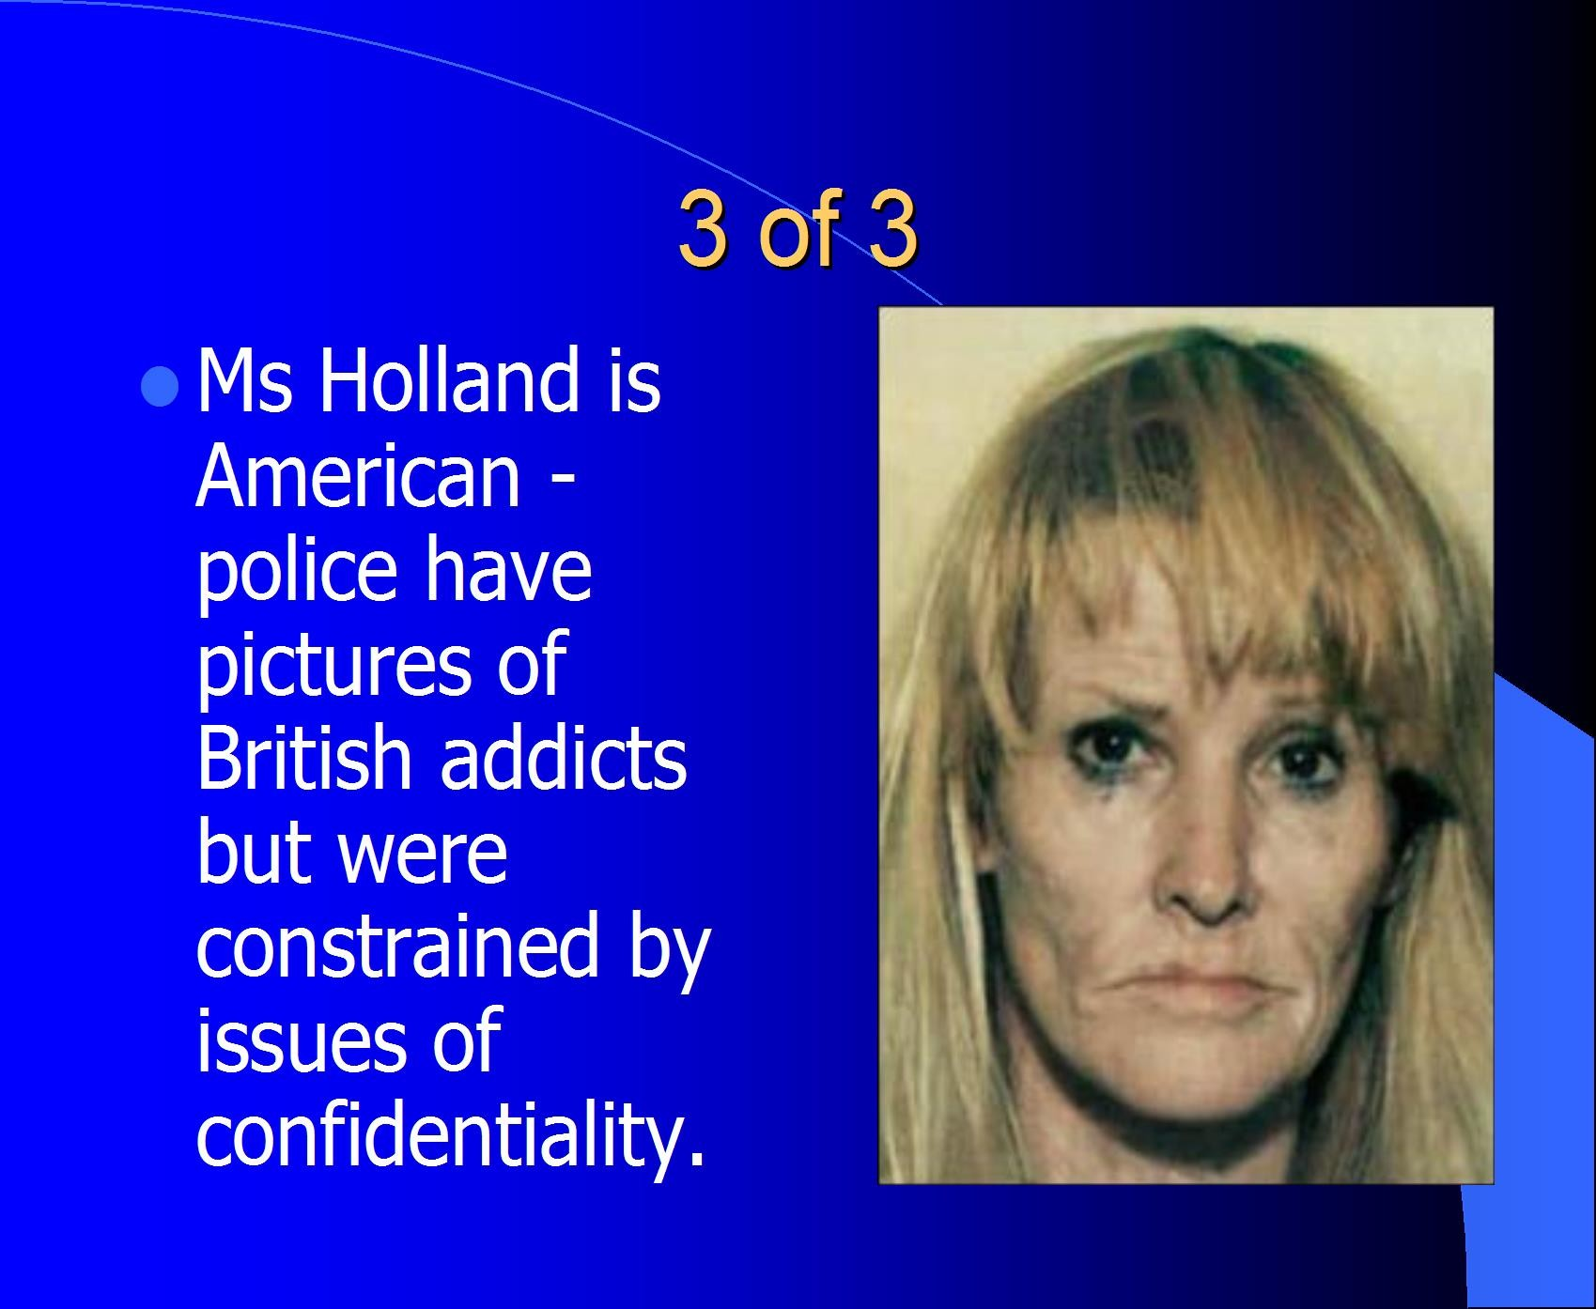

Slide 26

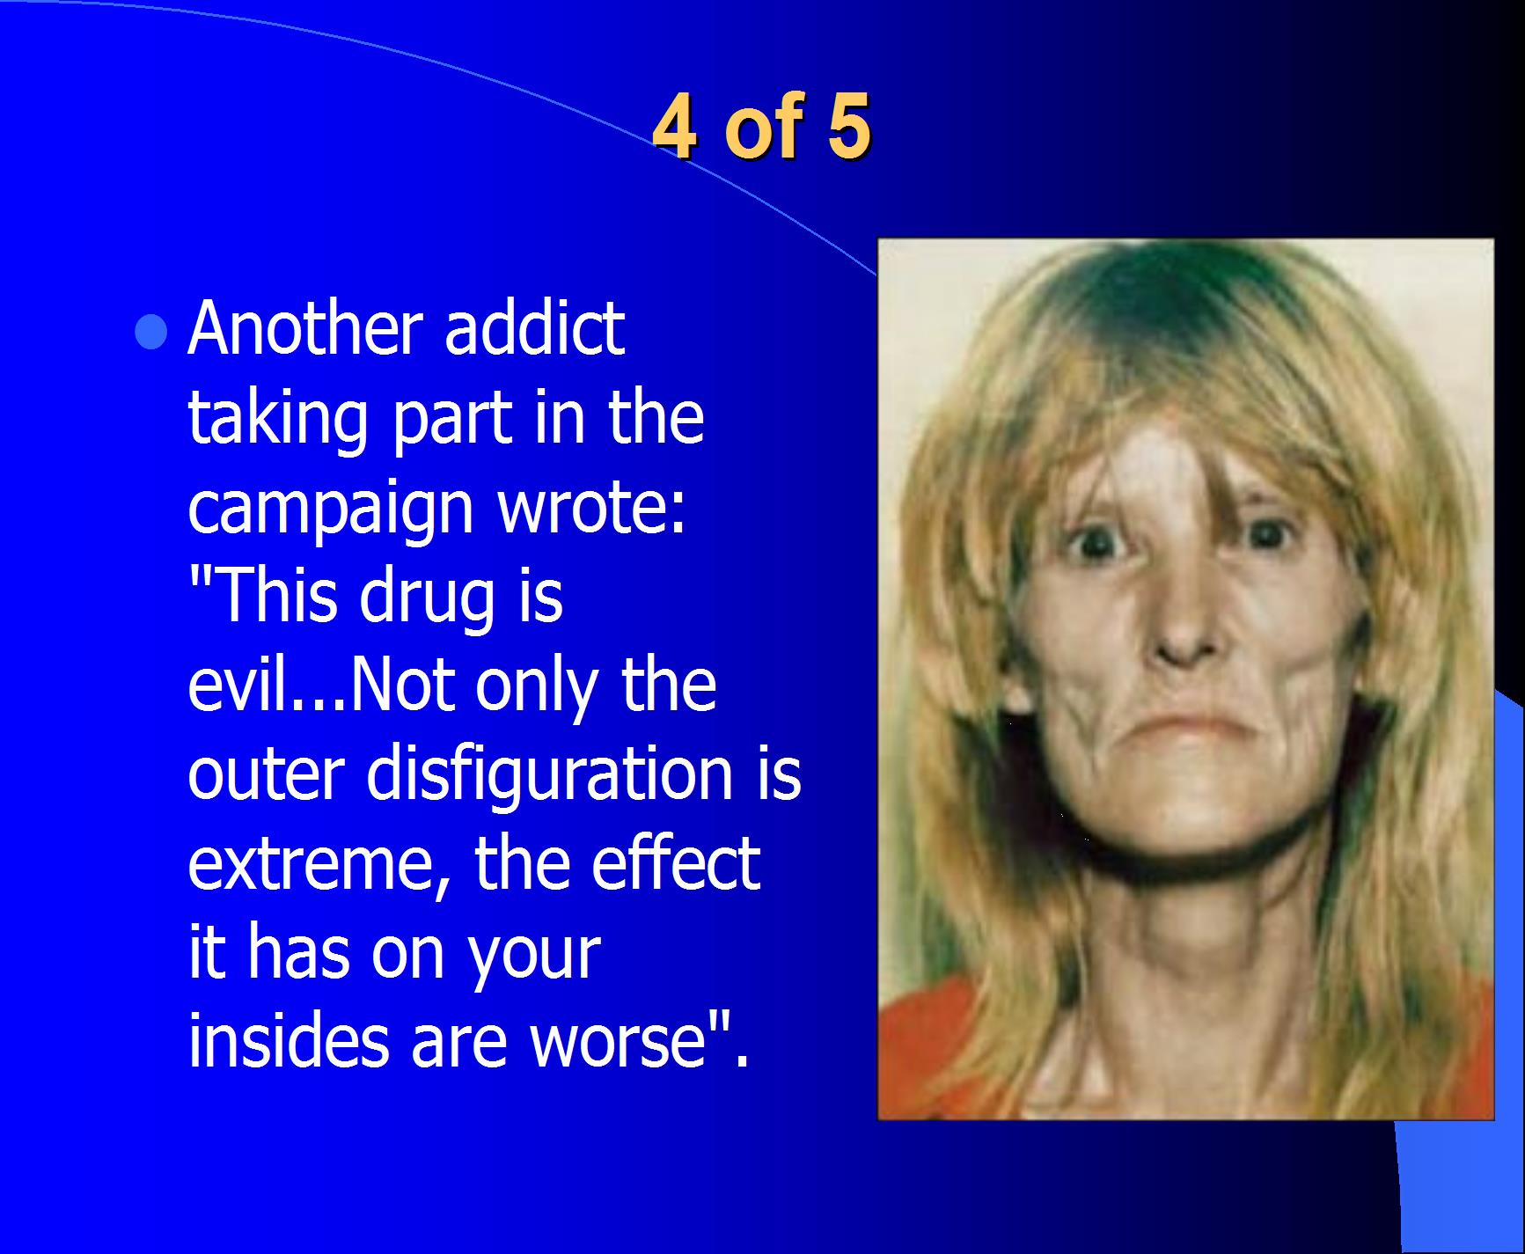

Slide 27
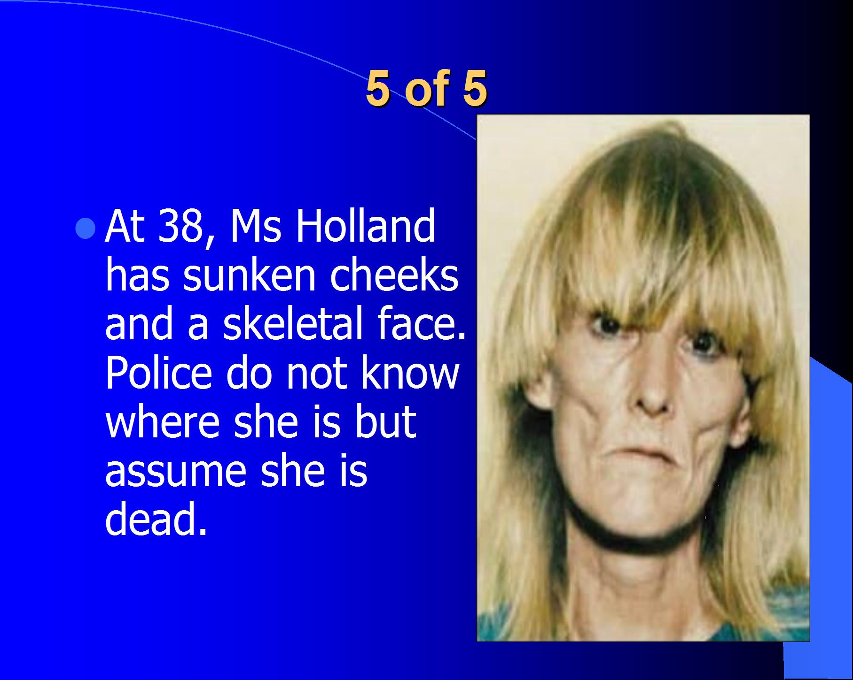

Slide 28

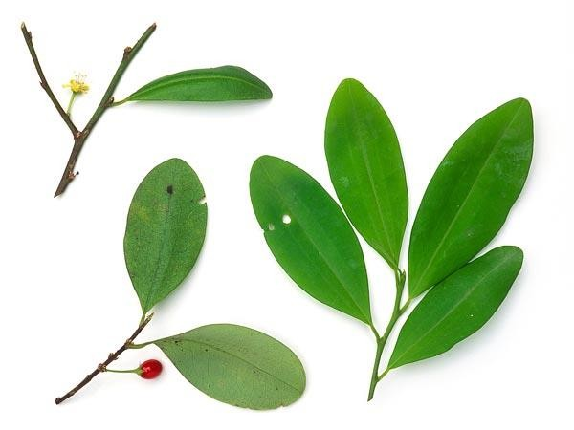
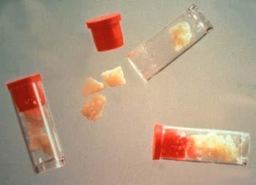
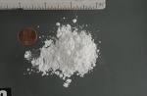
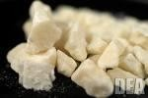
Cocaine + CRACK
Cocaine is a stimulant drug-more alert and energetic
Cocaine is a white powder comes from the leaves of coca plant

Can be one of
the hardest drugs to quit

Slide 29

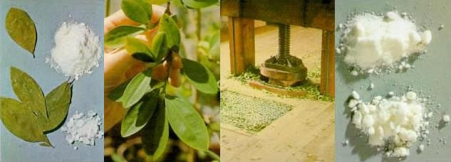
^{C} ºCoc^{c}aiªne^{i}m^{n}ak^{e}es ⁺peo^{C}pl^{R}e f^{A}ee^{C}l e^{K}nergetic, talkative,
alert and euphoric
More aware of senses (increases sound, touch, sight and sexuality)
Reduces hunger and need to sleep
Increase in self-control and confidence
High doses cause panic attacks, psychotic episodes (paranoia), violent behavior

Slide 30

Cocaine - effects
Blood vessels thicken and constrict, reduce flow of
oxygen to heart
Heart muscles work harder can lead to heart attack or stroke
Raises blood pressure, can explode weakened blood vessels in brain
Small amount can lead to overdose
Overdose can cause seizure or heart failure
Snorting cocaine can cause sinus infection and loss of smell

Slide 31

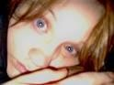
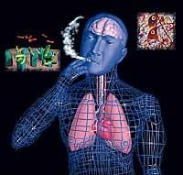
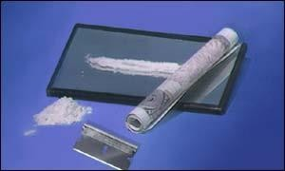
Cocaine – long time effects
Damage tissues in nose, cause hole in nose
Damage lungs-severe chest pains, breathing problems, high temperatures
Cocaine increases the same chemicals in t brain that make people feel good when they eat, drink or have sex
he

Slide 32
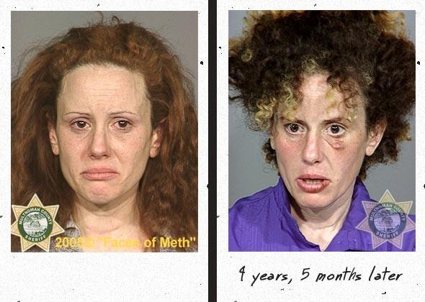
Crystal meth
Some pictures of effects of methamphetamine

Slide 33
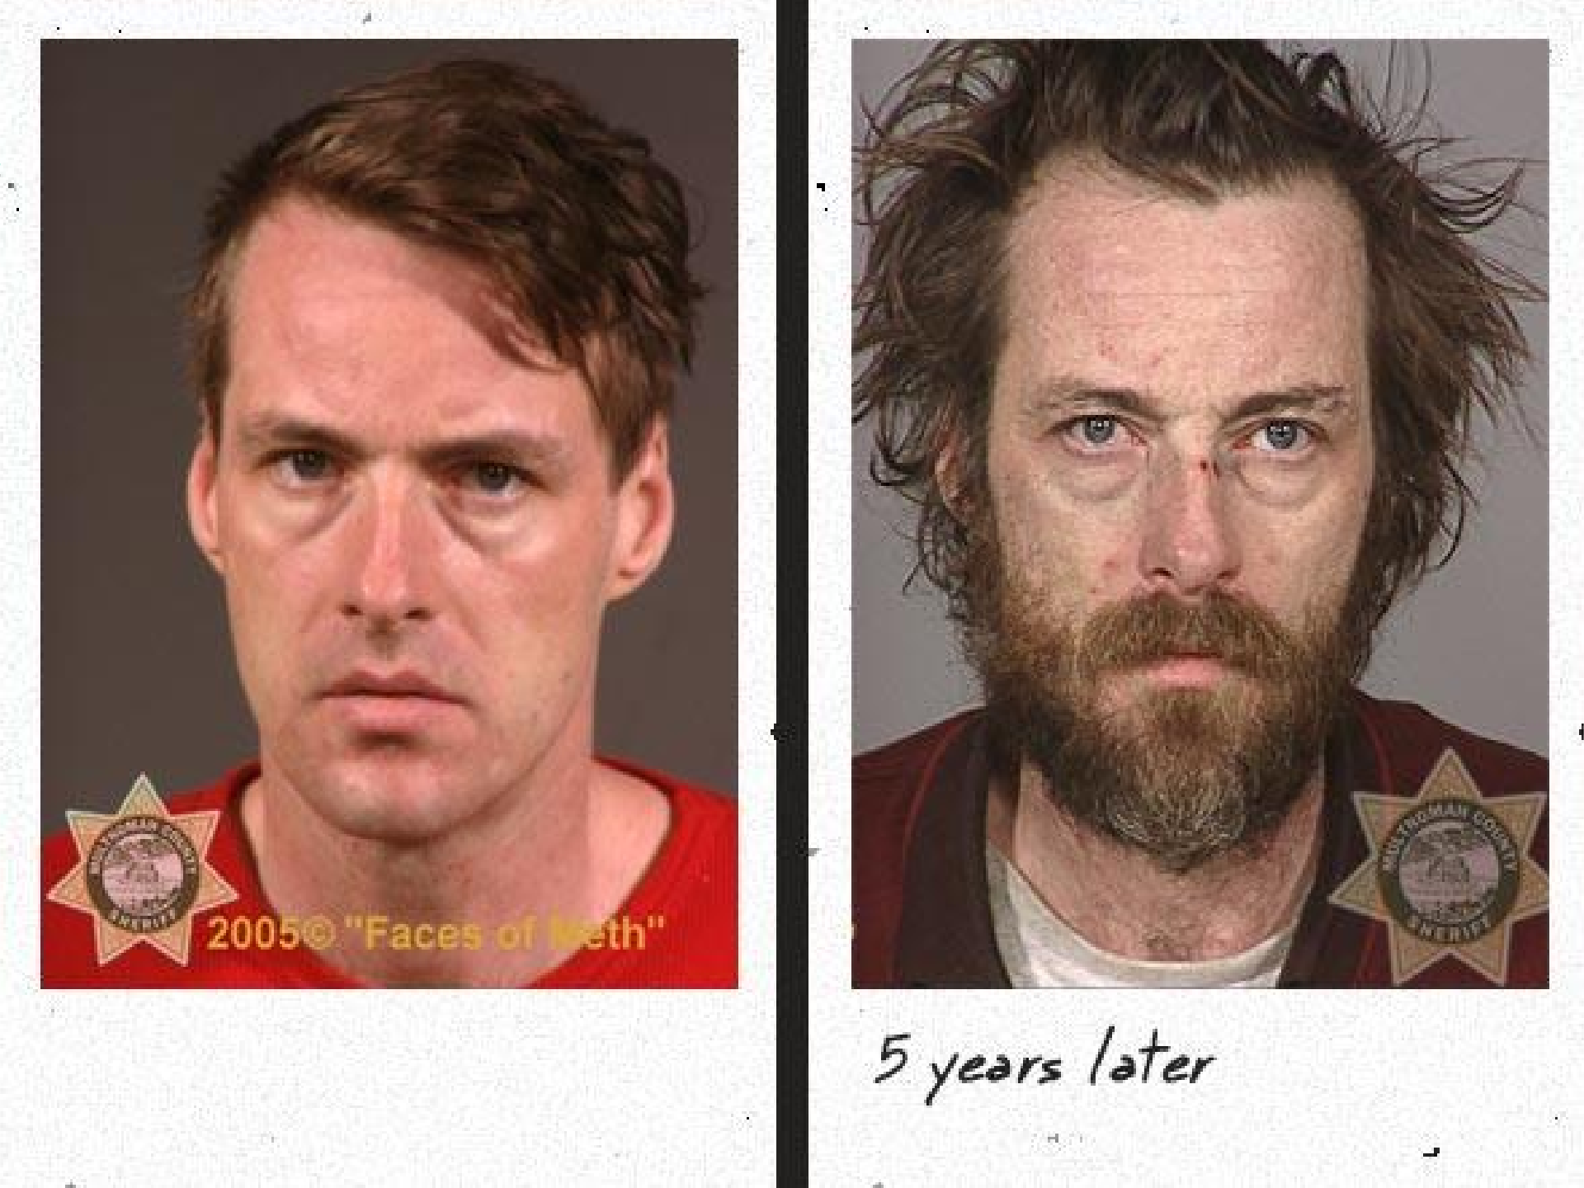


Slide 34



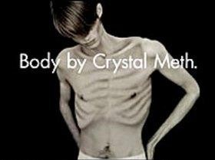

Slide 35
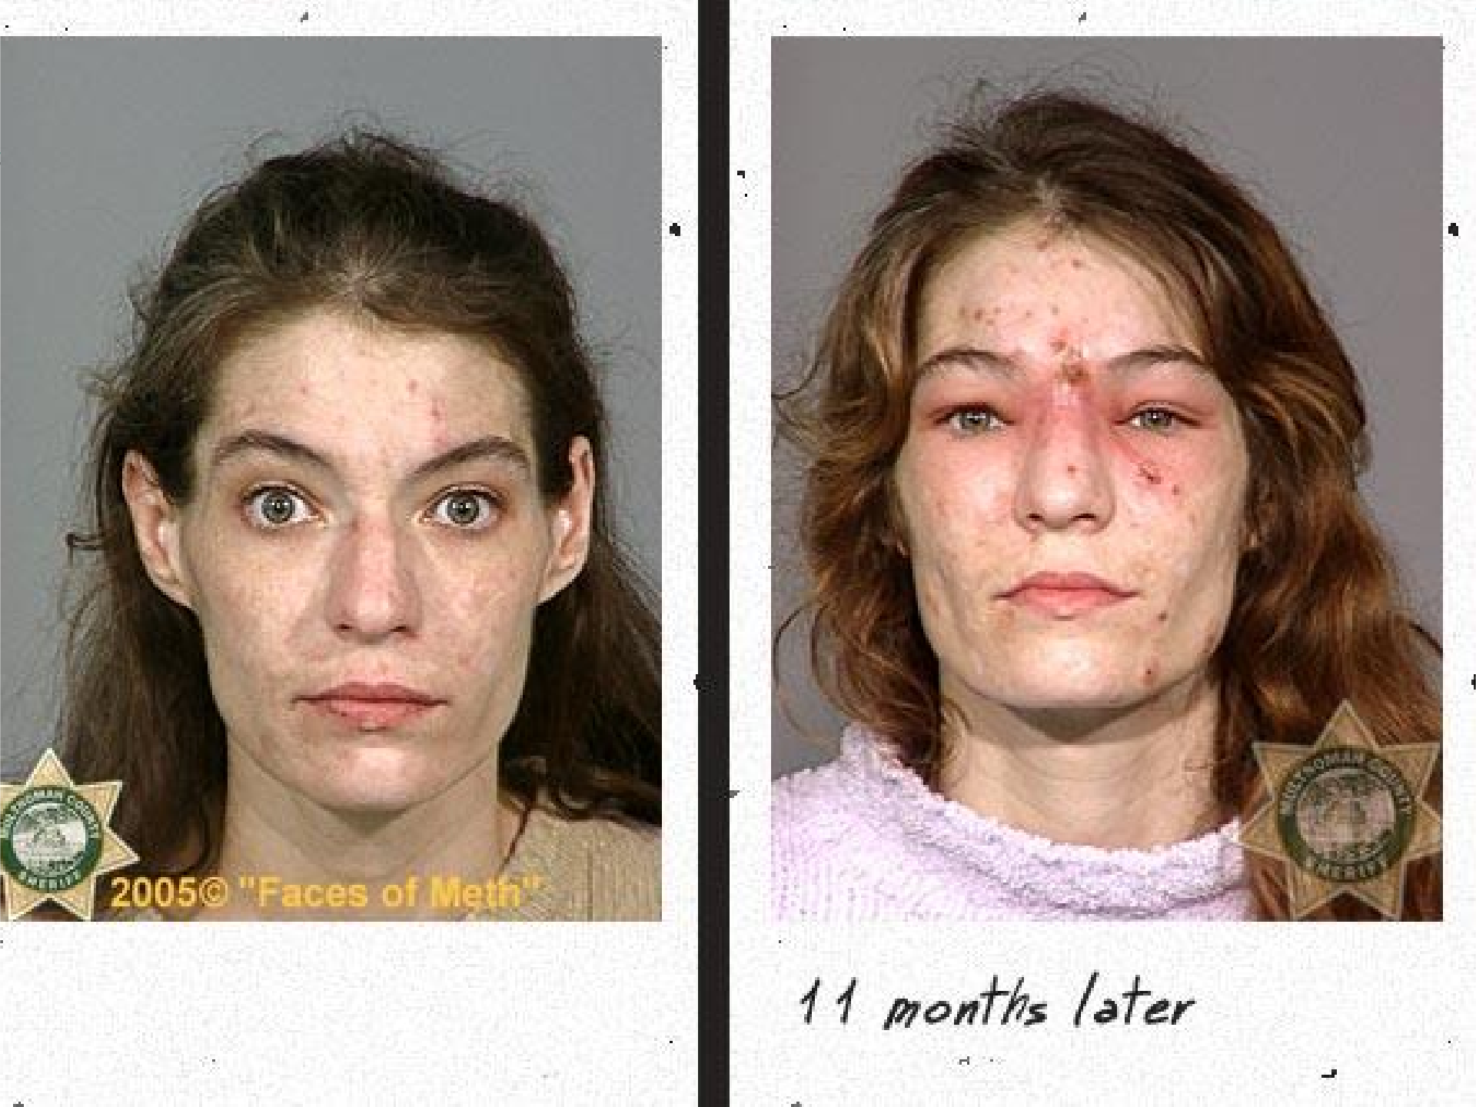


Slide 36
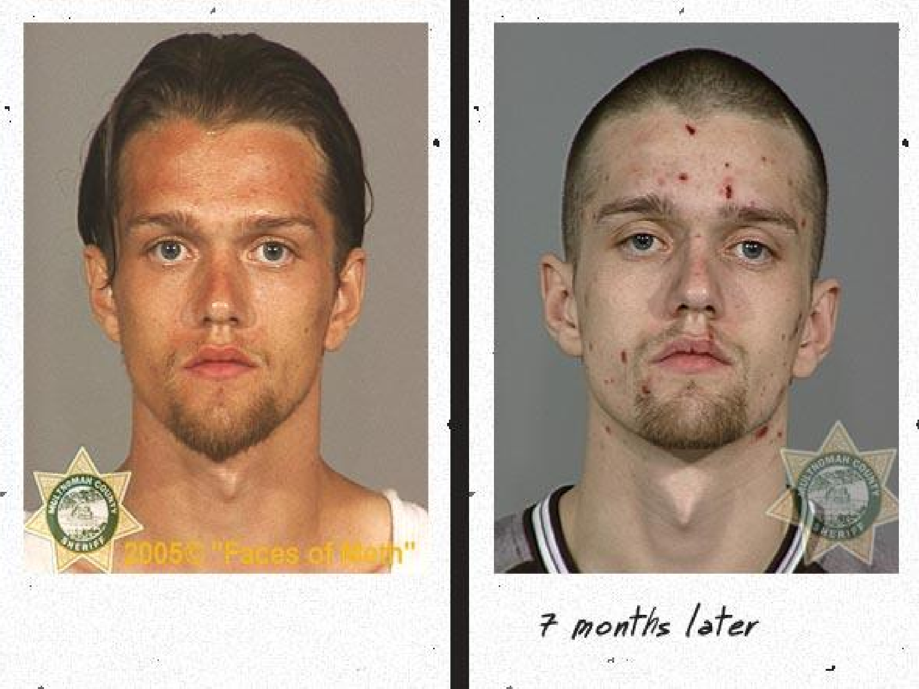


Slide 37
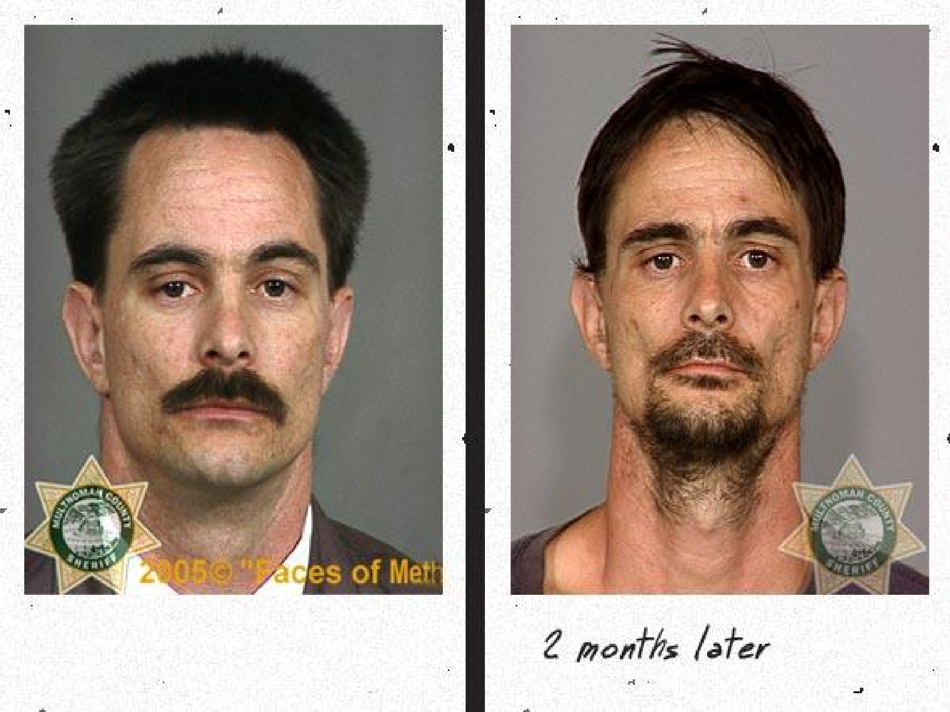

Slide 38
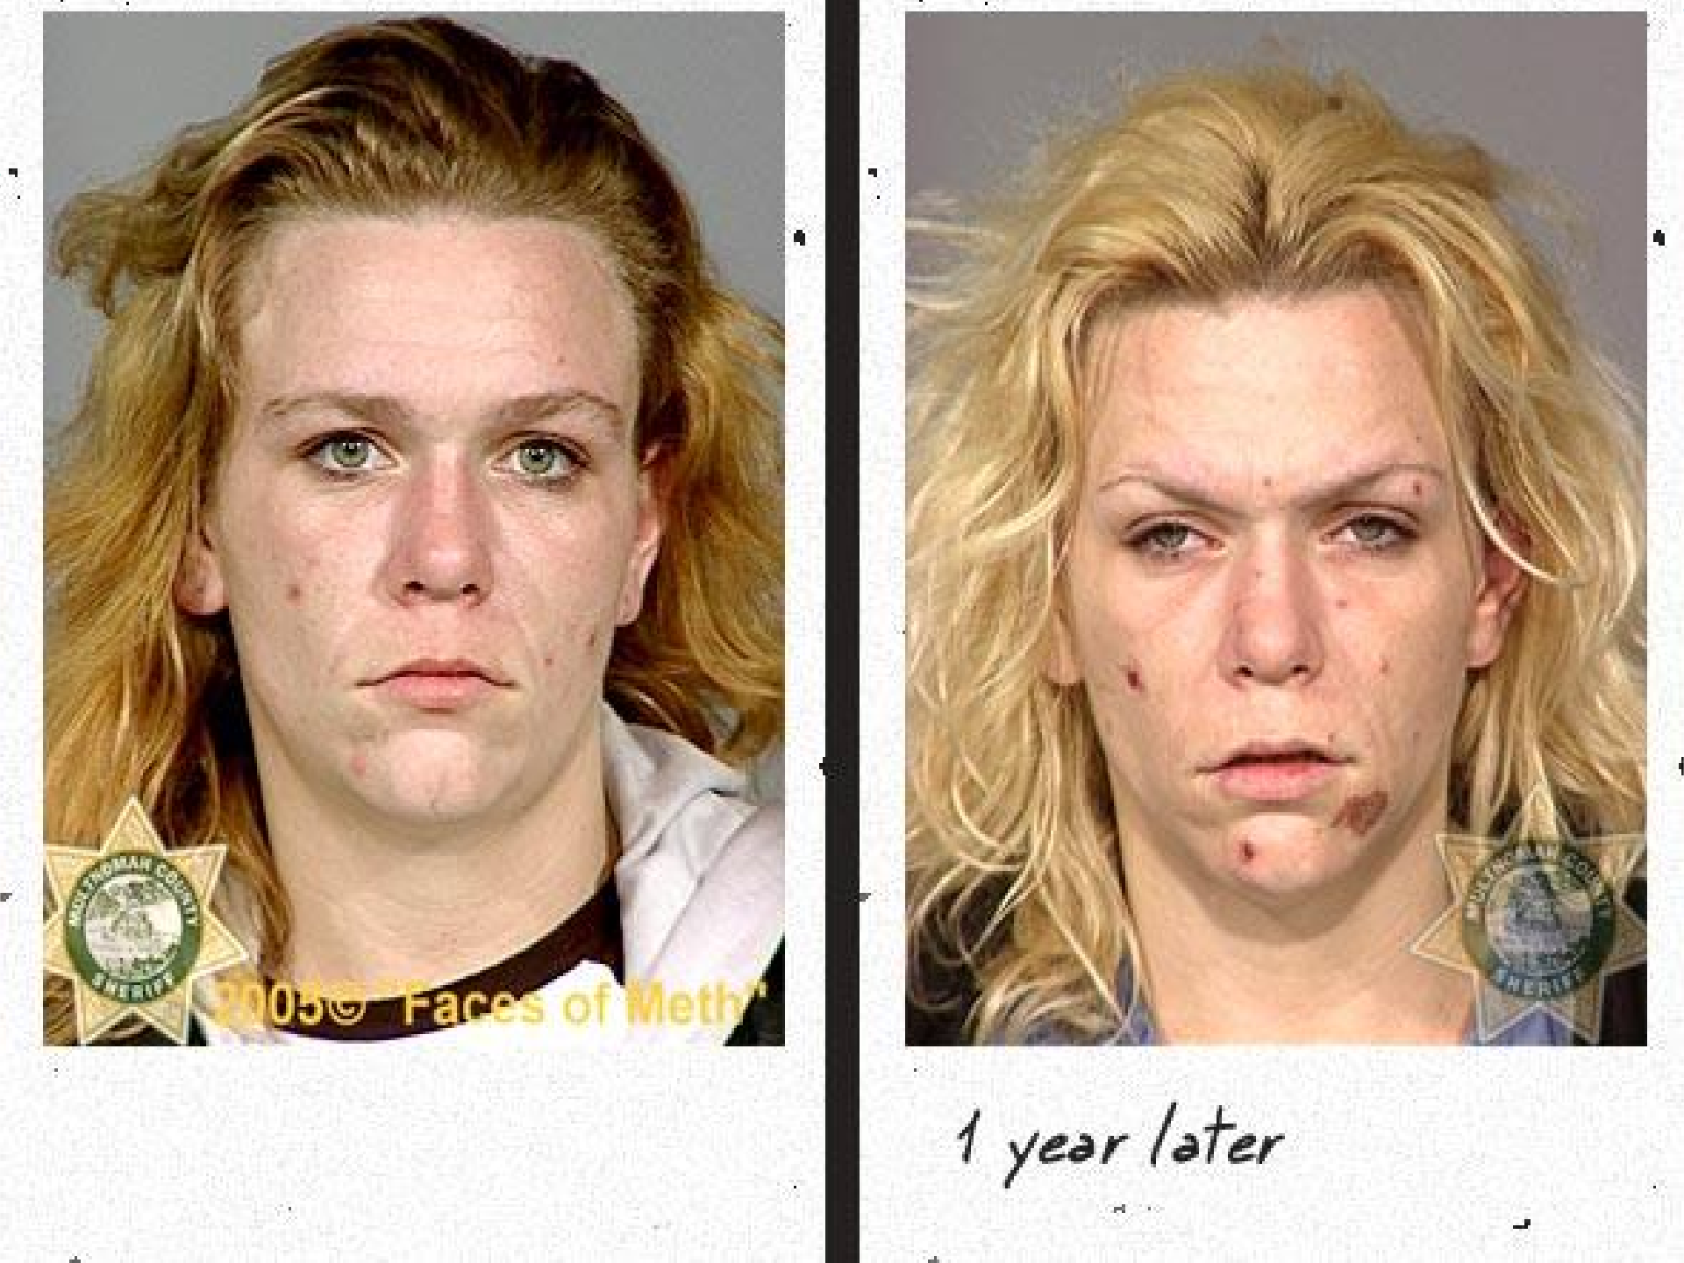


Slide 39
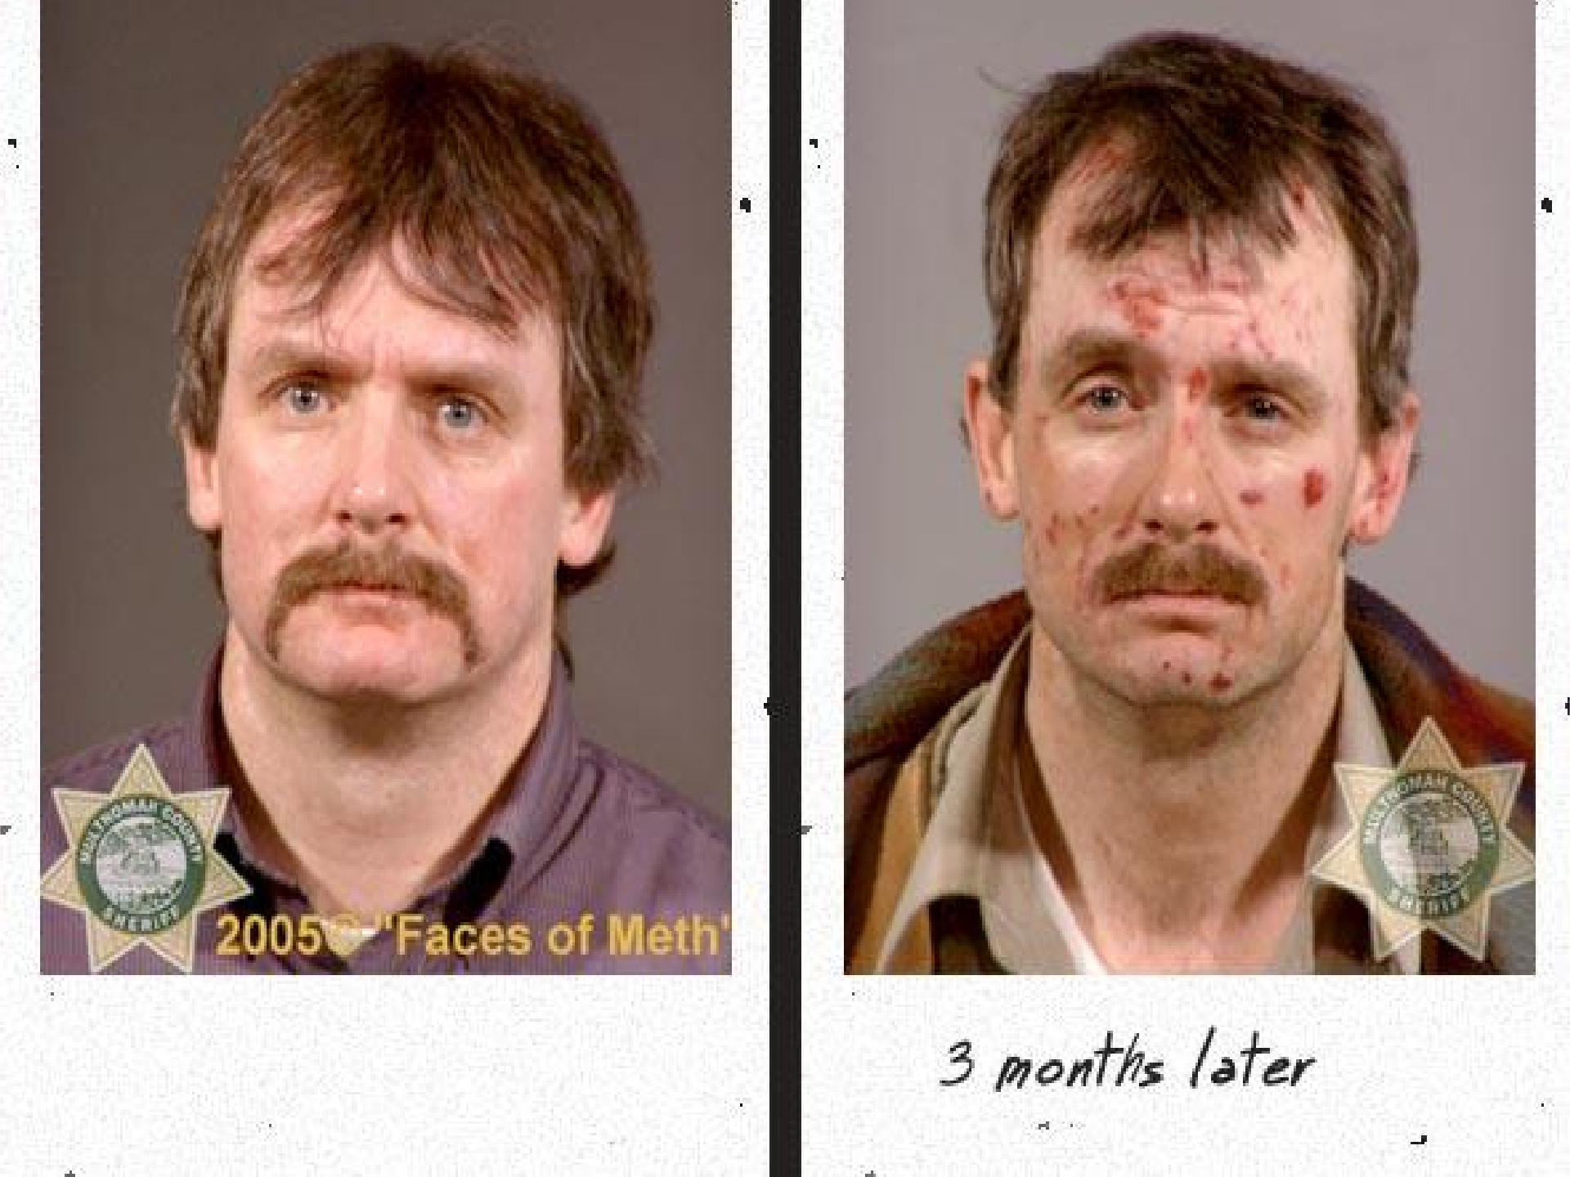


Slide 40

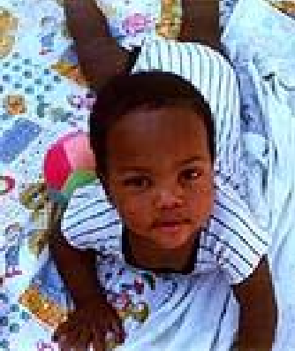
EFFECTS OF DRUG USE ON
CHILD
Miscarriages
Premature birth
Low birth weight
Birth defects
Developmental problems
A baby’s health problems, if caused by a drug
will continue to grow as the child grows.

Slide 41
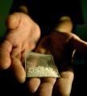
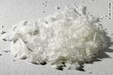
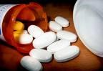
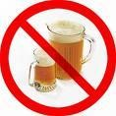














Slide 42








Slide 43












Slide 44











Slide 45











Slide 46









Slide 47

Reasons for drug addiction:
Curiosity
To relieve boredom.
People suffering from anxiety, depression or other mental illnesses use drugs and alcohol to ease their suffering.
People see family members, friends, role models or entertainers using drugs.
People get physically injured and unintentionally get hooked on prescribed drugs.
People think drugs will help them fit in.

Slide 48








RISK FACTORS
Family management problems
poorly defined rules
inconsistent application of rules
lack of monitoring
excessive discipline
negative communication patterns
poor anger management

Slide 49

PREVENTIVE METHODS:
Since many people who try to stop doing drugs on their own experience Withdrawal Symptoms, which are hard to ignore, going to a rehabilitation center is a safe way out.
Awareness programs like our own Ethics and values class may prevent many students from succumbing to peer pressure and doing drugs.
Personal counseling and assistance may also help.

Slide 50








PROTECTIVE FACTORS
Positive relationships with adults

Slide 51

Recovery From Drug Addiction:
Exploring the treatment options
Finding support
Learning new habits
Controlling triggers and avoiding cravings
Never lose hope

Slide 52





NGOs Helping to recover :

Slide 53

Australia: Standard for the Uniform Scheduling of Drugs and Poisons
Belize: Misuse of Drugs Act (Belize)
Canada: Controlled Drugs and Substances Act
Estonia: Narcotic Drugs and Psychotropic Substances Act (Estonia) India: Narcotic Drugs and Psychotropic Substances Act Netherlands: Opium Law
New Zealand: Misuse of Drugs Act 1975
The Philippines: Comprehensive Dangerous Drugs Act of 2002 Poland: Drug Abuse Prevention Act 2005 (article in Polish Wikipedia) Republic of Ireland: Misuse of Drugs Act (Ireland)
Republic of South Africa: Drugs and Drug Trafficking Act 1992
Singapore: Misuse of Drugs Act (Singapore)
Thailand: Psychotropic Substances Act (Thailand) and Narcotics Act United Kingdom: Misuse of Drugs Act 1971and Drugs Act 2005 United States: Controlled Substances Act
The major drug laws of India are the Narcotic Drugs and Psychotropic Substances Act (1985) and the Prevention of Illicit Trafficking in Narcotic Drugs and Psychotropic Substances Act (1985).

Slide 54

THE NARCOTIC DRUGS AND PSYCHOTROPIC
SUBSTANCES ACT, 1985 (shortened to NDPS Act). Under the NDPS Act, it is illegal for a person to produce/manufacture/cultivate, possess, sell, purchase, transport, store, and/or consume any narcotic drug or psychotropic substance.
Under one of the provisions of the act, the Narcotics Control Bureau was set up with effect from March 1986. The Act is designed to fulfill India's treaty obligations under the Single Convention on Narcotic Drugs, Convention on Psychotropic Substances, and United Nations Convention Against Illicit Traffic in Narcotic Drugs and Psychotropic Substances. The Act has been amended three times - in 1988, 2001, and most recently in 2014.

Slide 55

The Act extends to the whole of India and it applies also to all Indian citizens outside India and to all persons on ships and aircraft registered in India.
Prevention of Illicit Trafficking in Narcotic Drugs and Psychotropic Substances Act:
Narcotics Control Bureau
The Narcotics Control Bureau (NCB) is the chief law enforcement and intelligence agency of India responsible for fighting drug trafficking and the abuse of illegal substances. It was created on 17 March 1986 to enable the full implementation of the Narcotic Drugs and Psychotropic Substances Act (1985) and fight its violation through the Prevention of Illicit Trafficking in Narcotic Drugs and Psychotropic Substances Act (1988).

Slide 56
Controlled Substances
The following list mentions the names of some substances banned or controlled in India under the NDPS Act.
The list uses the International Nonproprietary Name (INN) of the drugs but in some cases mentions drugs by their chemical name. Widely known drugs such as ganja, cocaine, heroin etc. are mentioned by those names.
Cultivation/production/manufacture, possession, sale, purchase, transport, storage, consumption or distribution of any of the following substances, except for medical and scientific purposes and as per the rules or orders and conditions of licences that may be issued, is illegal.

Slide 57

Along with some isomers there are about 235 controlled substances-Some important drugs are listed below
Coca derivatives
Coca leaf
Cocaine
Ganja
Heroin
Opium
Opium derivatives
3-[2-(diethyl amino)ethyl]indole (N,N-Diethyltryptamine)
3-[2-(dimethylamino) ethyl] indole (N,N-
Dimethyltryptamine)
Temazepam
Tetrazepa
Triazolam
Vinylbital
Zolpidem

Slide 58


